Slide 1

Sae – aero micro capstone
Yaqoub Almounes – Budget Liason
John Cowan – Website Developer
Josh Gomez – Project Manager
Mohammad Qasem – Document Manager
Michael Medulla – Client Contact

Slide 2
Project Description
SAE International holds annual Collegiate Aero Design competition
Universities from around the world showcase aircraft designs of various sizes to convey use of resources and efficient design
Micro class required to design a radio controlled aircraft which carries the highest payload fraction possible, while maintaining lowest empty weight possible.
Judges score each design based on written report, oral presentation, flight results.
No changes since ME 476C in Design Rules and Regulations

Slide 3
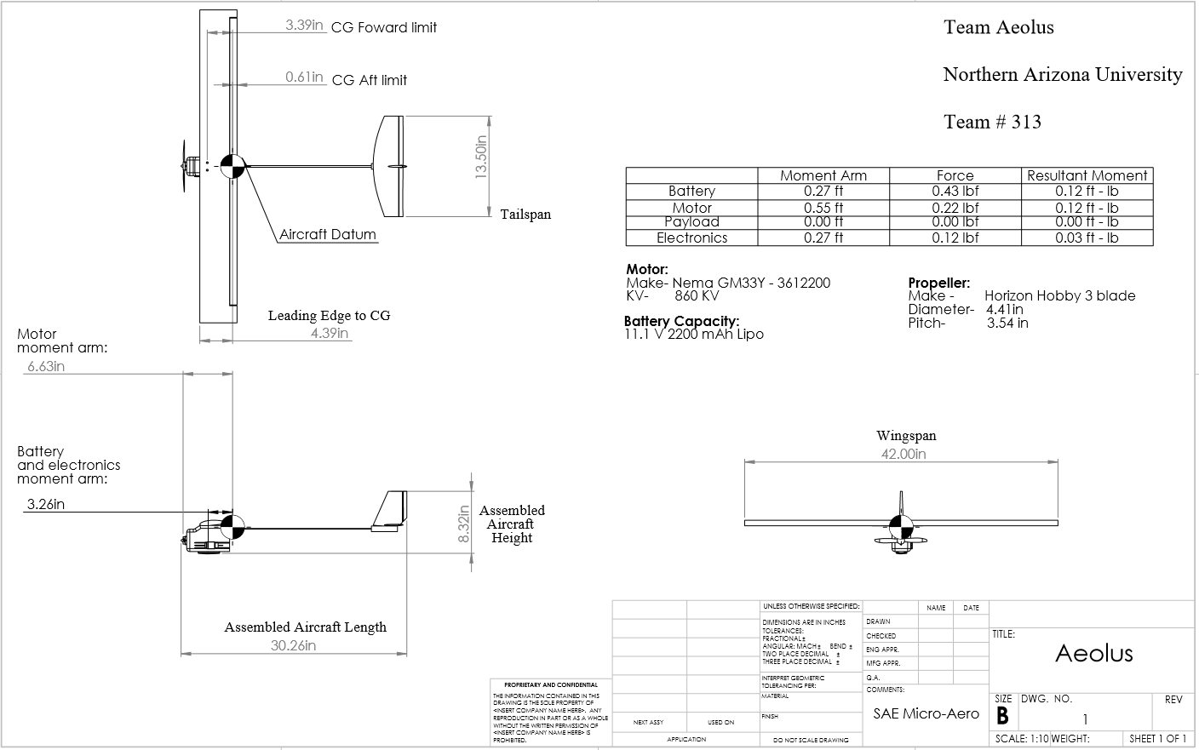
Updates
Figure 2: 2D Drawing Submitted to SAE

Slide 4
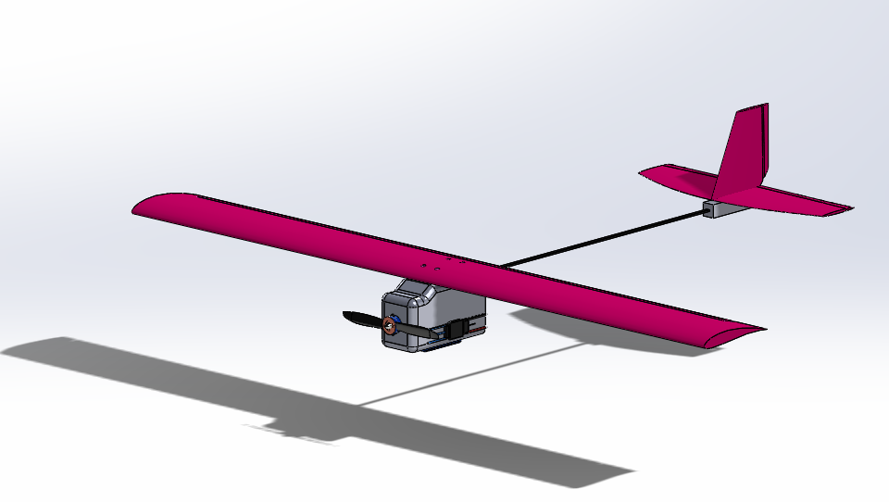
Updates
Figure 3: Tentative Design

Slide 5
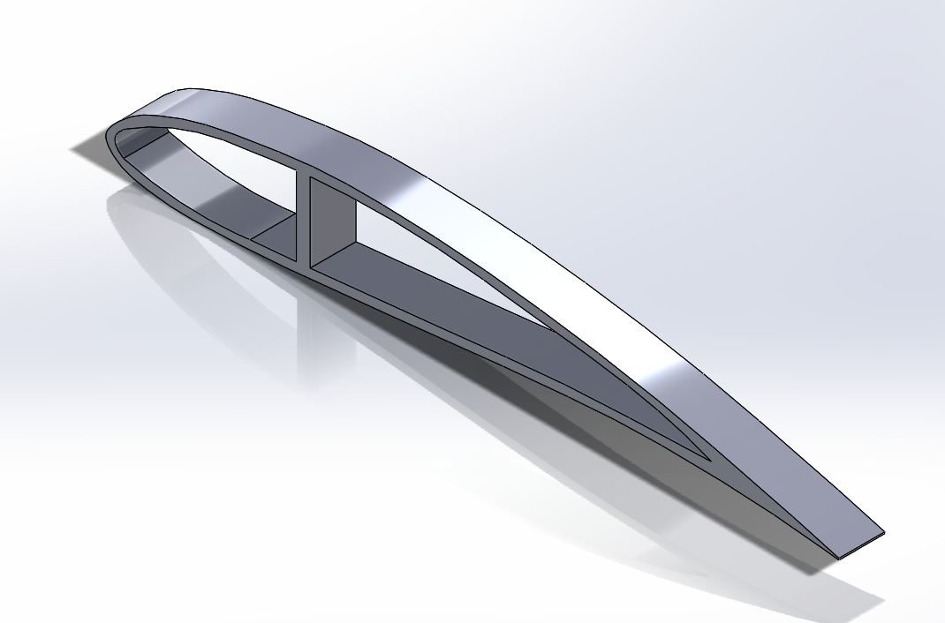
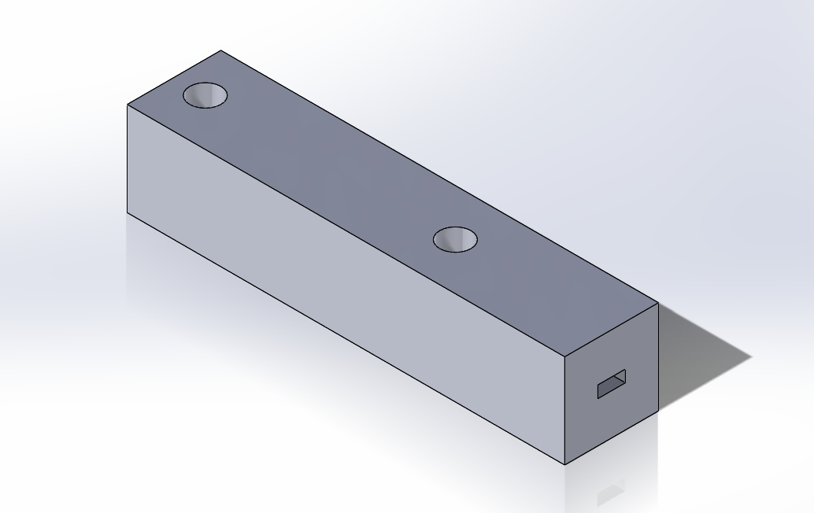
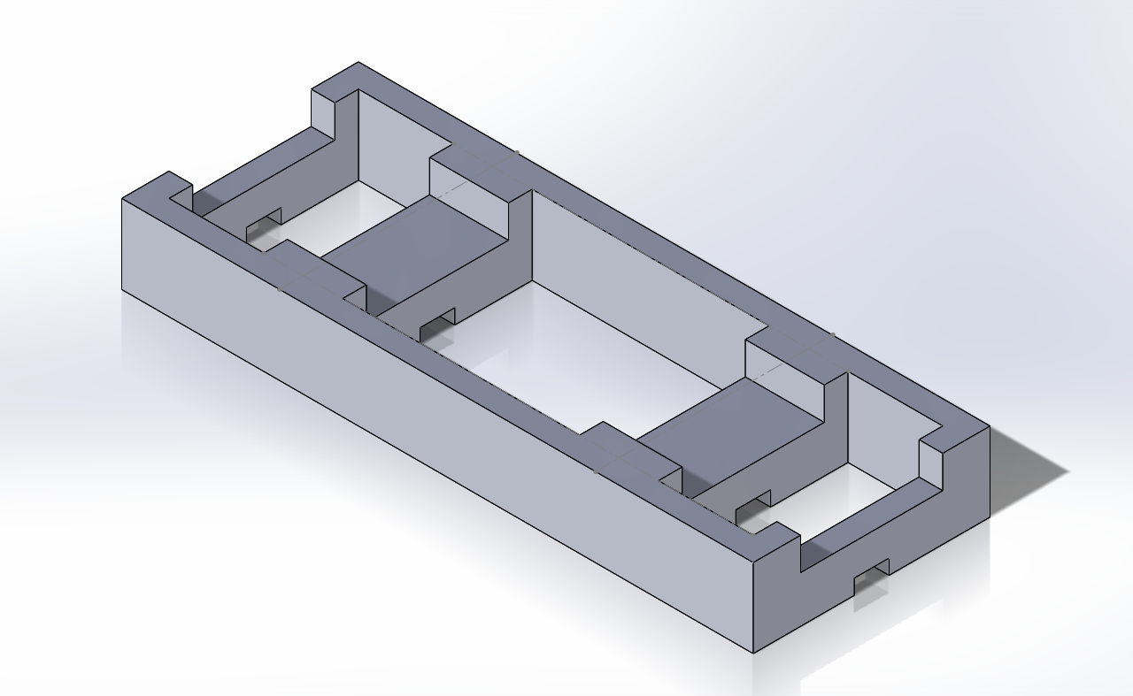
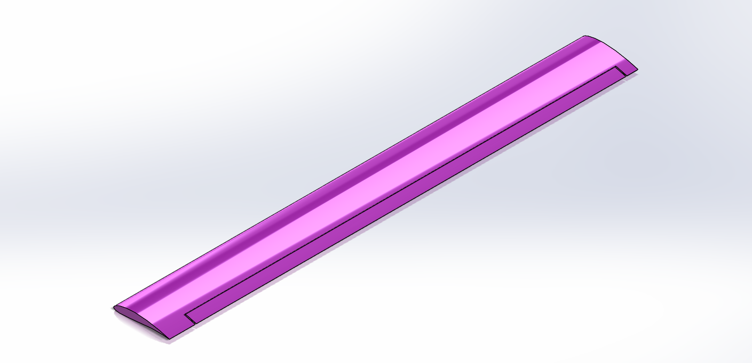
Manufacturing
Library 3D printing
Hot Wire Cutter for Wings, Tail and elevator
Figures 4: Airfoil Guide
Figures 5: Tail Mount
Figures 6: Wing Mount
Figure 7: Wing

Slide 6
Manufacturing
Roles | Responsibility
Cutting Wings, Tail, and H. Stabilizer | Yaqoub & Michael
Installation of Electronics | Mohammad
3D Printing | Josh & Michael
Securing Body (screws) | John
Cutting Ailerons, Elevators | John
Securing Propeller | Yaqoub

Slide 7
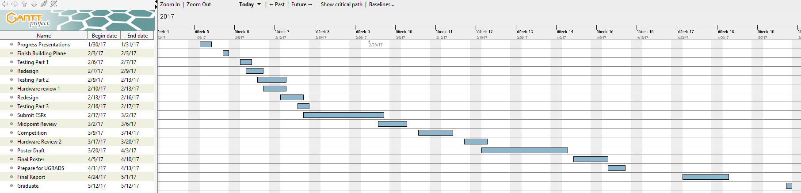
Schedule & Budget
Figure 8: Schedule

Slide 8
budget
Available = $1,500 | Quantity | Expenses to Date | Anticipated Expenses
Registration | 1 Time payment | $1,000
Hotels | 1 |  | $320
Brushless Motor | 1 | $25
Foam Sheet (4x8) | 1 | $15
Carbon Fiber Rods | 2 | $6.5 x 2 = $13
Carbon Fiber Tube | 1 | $7
Servos | 4 | $5 x 4 = $20
Prop | 1 |  | $5
Cables | 4 |  | $2 x 4 = $8
Set of Hinges (15) | 1 | $4
Control Horns Set | 1 | $5
Firewall/ Engine Mount | 1 | $5
Miscellaneous | TBD |  | $20
Total Spent |  | $1,094 | $353
Total Spent (Anticipated and Actual Spent)
$1,447
Remaining Balance
$1,500 – $1,447 = $53
Items in yellow are new expenses added since ME 476C

Slide 9
Thank you

